Slide 1
Types of Business Intelligence Tools and Applications
Ad hoc analysis
Online Analytical processing
Mobile BI
Real time BI
Operation Intelligence
Open-Source BI
Embedded BI
Collaborative BI
Location Intelligence
Business intelligence vendors and market
Sehrish Aqeel
www.aisciences.io

Slide 2
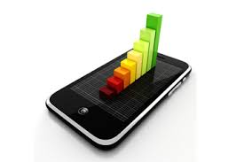

Mobile Business Intelligence
Mobile business intelligence is the transfer of business intelligence from the desktop to mobile devices such as the BlackBerry, iPad, and iPhone.
The ability to access analytics and data on mobile devices or tablets rather than desktop computers is referred to as mobile business intelligence.
The business metric dashboard and key performance indicators (KPIs) are more clearly displayed.

Slide 3
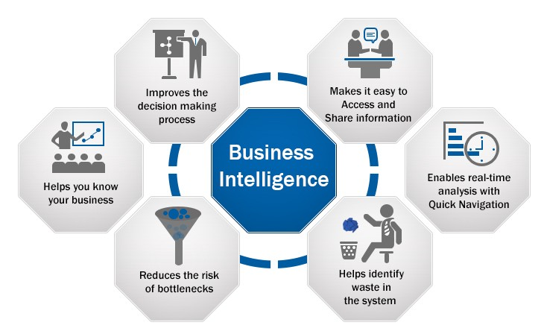

Slide 4
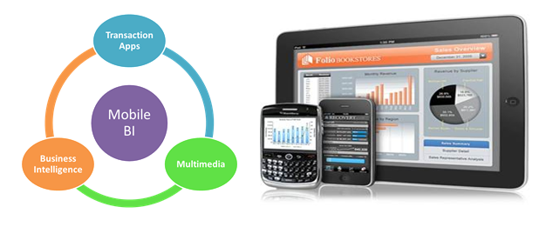
Advantages of Mobile BI
▓ Simple Access ▓ Competitive Advantage
▓ Easy Decision Making ▓ Enhanced Productivity

Slide 5
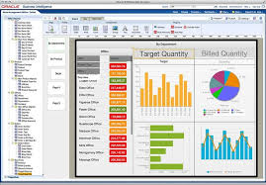
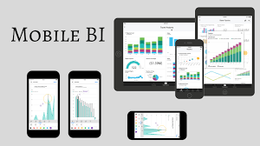
Tools to use for BI

